Slide 1
Unit - 4: Registers and Counters
REGISTERS:
A clocked sequential circuit consists of a group of flip‐flops and combinational gates. The flip‐flops are essential because, in their absence, the circuit reduces to a purely combinational
circuit.
A register is a group of flip‐flops, each one of which shares a common clock and is capable of storing one bit of information.
An n ‐bit register consists of a group of n flip‐flops capable of storing n bits of binary information.
In addition to the flip‐flops, a register may have combinational gates that perform certain data‐processing tasks.

Slide 2
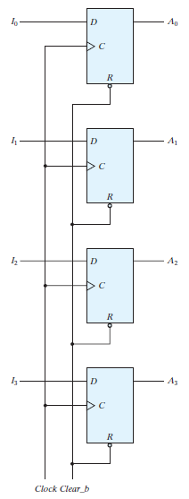
FIGURE: Four‐bit register

Slide 3
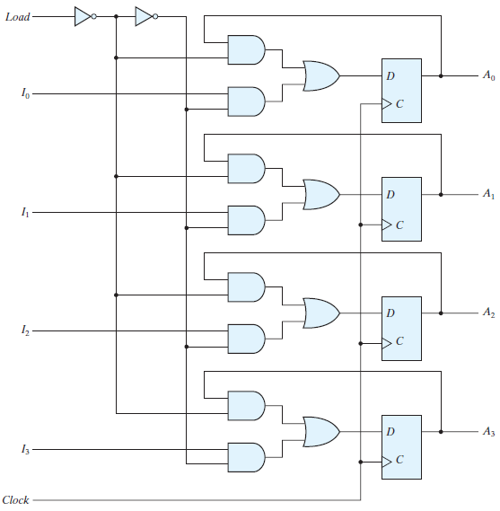
Register with Parallel Load
FIGURE: Four‐bit register with parallel load

Slide 4
SHIFT REGISTERS:
A register capable of shifting the binary information held in each cell to its neighboring cell, in a selected direction, is called a shift register.
The logical configuration of a shift register consists of a chain of flip‐flops in cascade, with the output of one flip‐flop connected to the input of the next flip‐flop.
All flip‐flops receive common clock pulses, which activate the shift of data from one stage to the next.
The simplest possible shift register is one that uses only flip‐flops, as shown in the following Fig. The output of a given flip‐flop is connected to the D input of the flip‐flop at its right. This shift register is unidirectional (left‐to‐right). Each clock pulse shifts the contents of the register one bit position to the right.

Slide 5
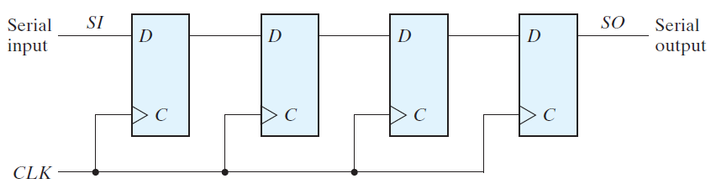
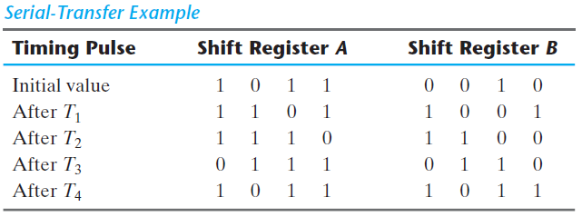
FIGURE: Four‐bit shift register
Serial Transfer

Slide 6
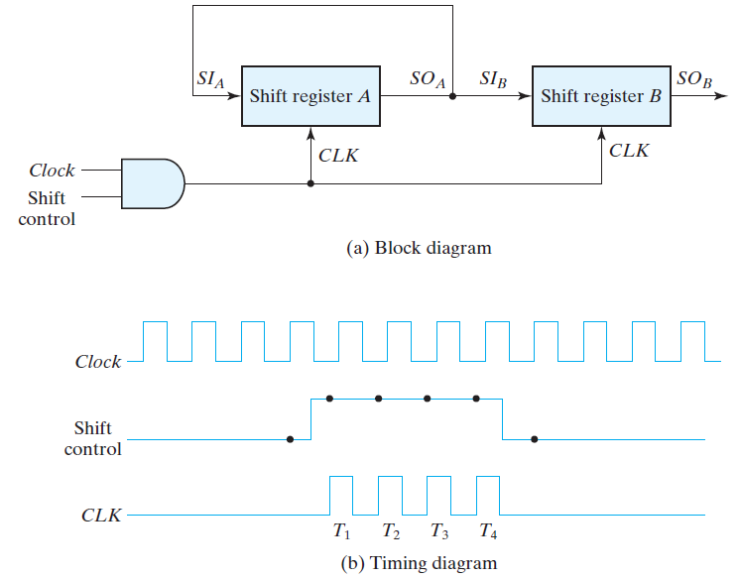
FIGURE: Serial transfer from register A to register B

Slide 7
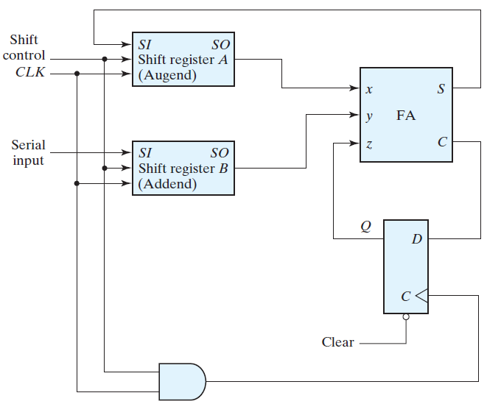
Serial Addition:
FIGURE: Serial adder

Slide 8
The operation of the serial adder is as follows:
Initially, register A holds the augend, register B holds the addend, and the carry flip‐flop is cleared to 0.
The outputs ( SO ) of A and B provide a pair of significant bits for the full adder at x and y.
Output Q of the flip‐flop provides the input carry at z.
The shift control enables both registers and the carry flip‐flop, so at the next clock pulse, both registers are shifted once to the right, the sum bit from S enters the leftmost flip‐flop of A, and the output carry is transferred into flip‐flop Q.

Slide 9
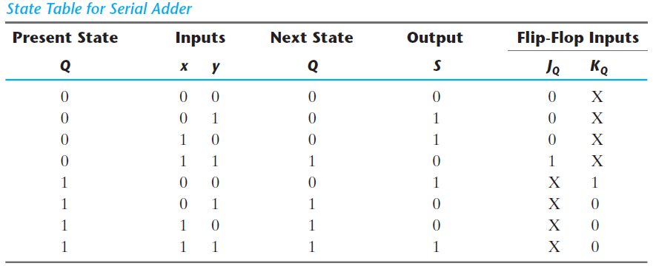
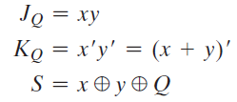
Redesign the serial adder with the use of a state table (using JK flip-flop.):

Slide 10
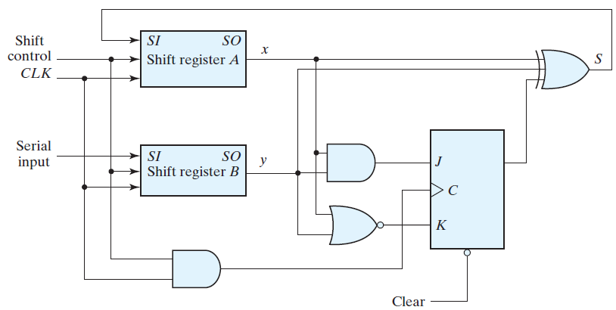
FIGURE: Second form of serial adder using JK Flip-flop.

Slide 11
Universal Shift Register:
Some shift registers provide the necessary input and output terminals for parallel transfer. They may also have both shift‐right and shift‐left capabilities.
The most general shift register has the following capabilities:
1. A clear control to clear the register to 0.
2. A clock input to synchronize the operations.
3. A shift‐right control to enable the shift‐right operation and the serial input and output lines associated with the shift right.
4. A shift‐left control to enable the shift‐left operation and the serial input and output lines associated with the shift left.
5. A parallel‐load control to enable a parallel transfer and the n input lines associated with the parallel transfer.
6. n parallel output lines.

Slide 12
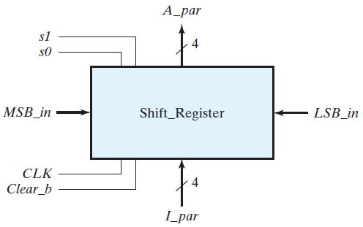
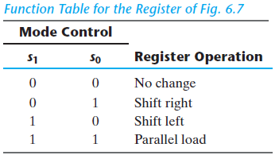
7. A control state that leaves the information in the register unchanged in response to the clock. Other shift registers may have only some of the preceding functions, with at least one shift operation.
A register capable of shifting in one direction only is a unidirectional shift register.
One that can shift in both directions is a bidirectional shift register. If the register has both shifts and parallel‐load capabilities, it is referred to as a universal shift register.

Slide 13
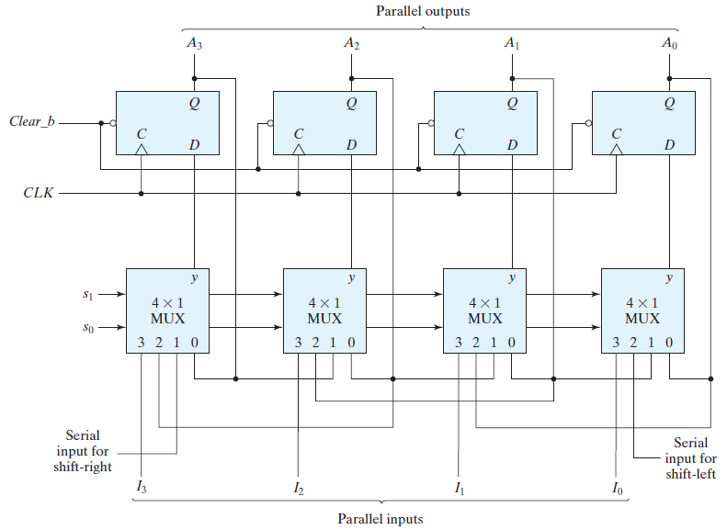
FIGURE: Four‐bit universal shift register

Slide 14
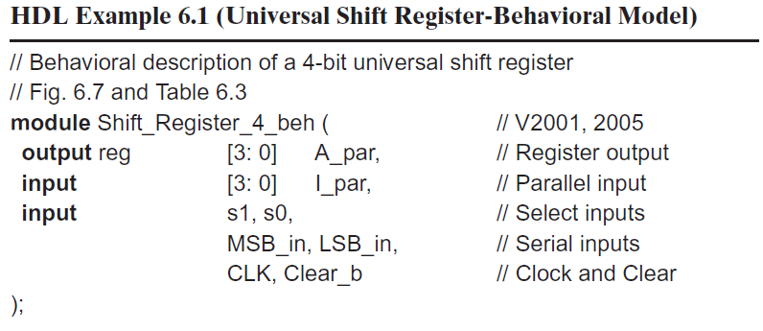
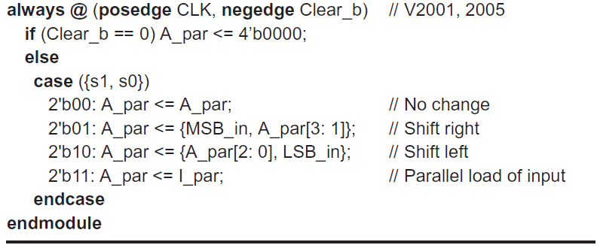
HDL FOR REGISTERS AND COUNTERS:

Slide 15
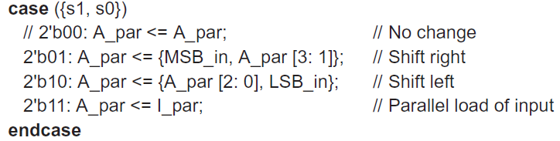
Consider the following alternative case statement for the shift register model:
Without the case item 2’b00, the case statement would not find a match between {s1, s0} and the case items, so register A_par would be left unchanged.

Slide 16
A structural model of the universal shift register can be described by referring to the logic diagram of Fig. (b).
The diagram shows that the register has four multiplexers and four D flip‐flops.
A mux and flip‐flop together are modeled as a stage of the shift register. The stage is a structural model, too, with an instantiation and interconnection of a module for a mux and another for a D flip‐flop.
For simplicity, the lowest‐level modules of the structure are behavioral models of the multiplexer and flip‐flop. Attention must be paid to the details of connecting the stages correctly.
The top‐level module declares the inputs and outputs and then instantiates four copies of a stage of the register.
The four instantiations specify the interconnections between the four stages and provide the detailed construction of the register as specified in the logic diagram.

Slide 17
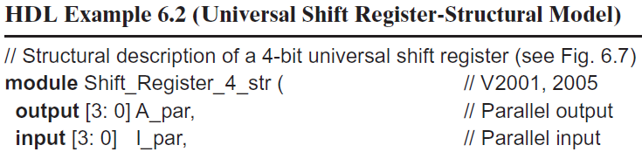
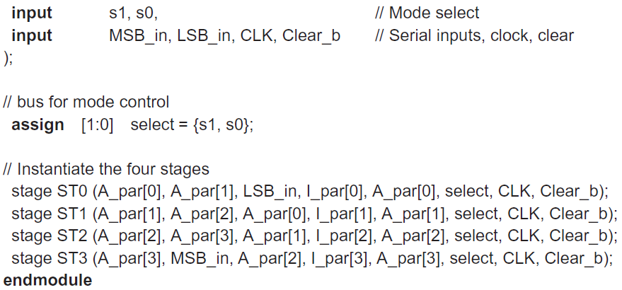

Slide 18
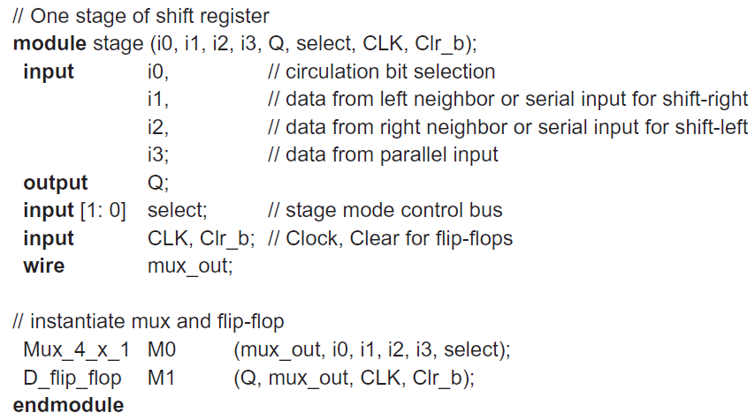

Slide 19
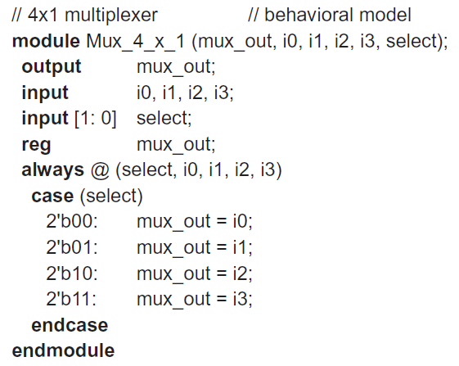

Slide 20
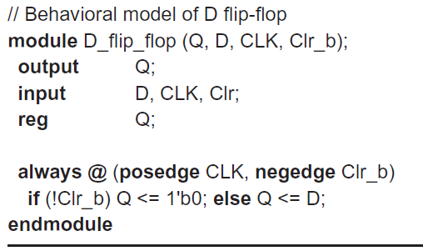

Slide 21
RIPPLE COUNTERS (Asynchronous Counters):
Binary Ripple Counter:
A binary ripple counter consists of a series connection of complementing flip‐flops, with the output of each flip‐flop connected to the C input of the next higher order flip‐flop.
The flip‐flop holding the least significant bit receives the incoming count pulses.
A complementing flip‐flop can be obtained from a JK flip‐flop with the J and K inputs tied together or from a T flip‐flop.
A third possibility is to use a D flip‐flop with the complement output connected to the D input.

Slide 22
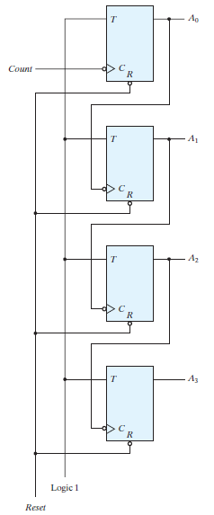
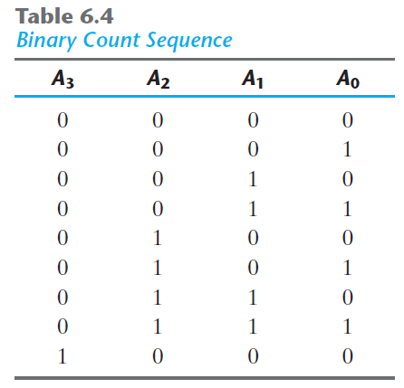
FIGURE: Four‐bit binary ripple counter with T Flip-flops.

Slide 23
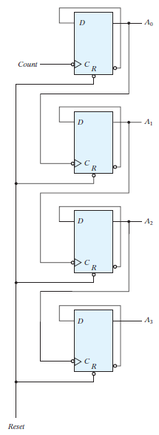
FIGURE: Four‐bit binary ripple counter with D Flip-flops.

Slide 24
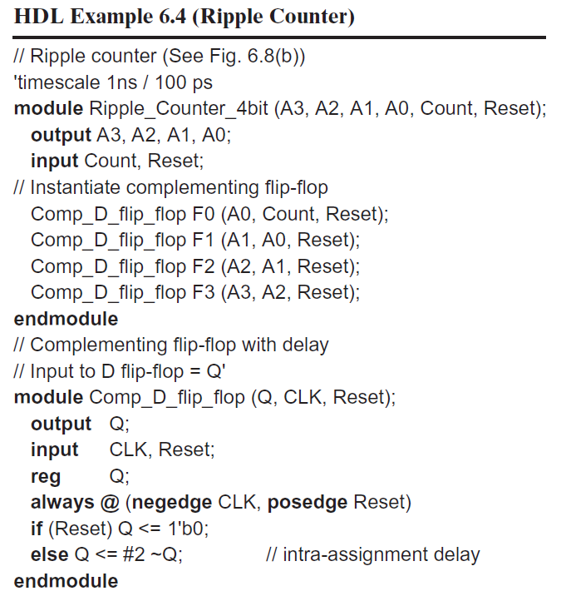

Slide 25
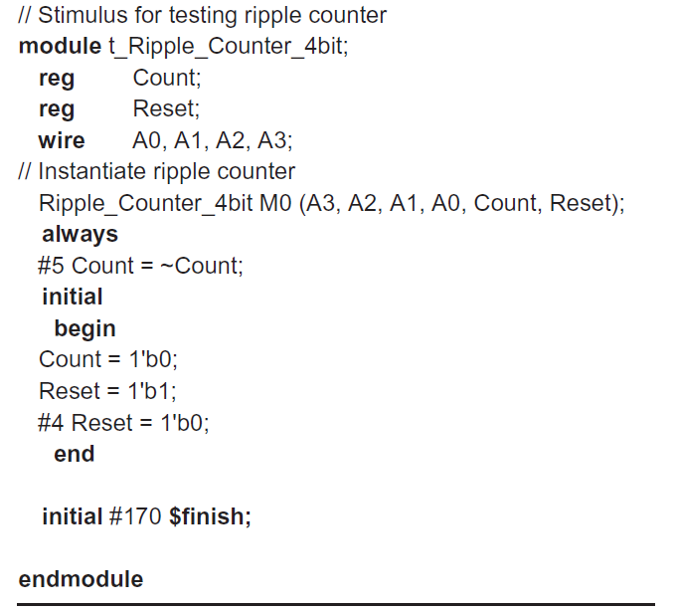

Slide 26
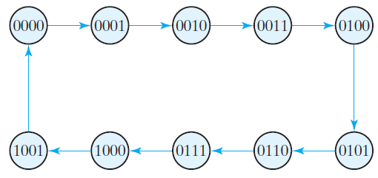
BCD Ripple Counter:
A ripple counter is an asynchronous sequential circuit. Signals that affect the flip‐flop transition depend on the way they change from 1 to 0.
FIGURE: State diagram of a decimal BCD counter
Remember that when the C input goes from 1 to 0, the flip‐flop is set if J = 1, is cleared if K = 1, is complemented if J = K = 1, and is left unchanged if J = K = 0.

Slide 27
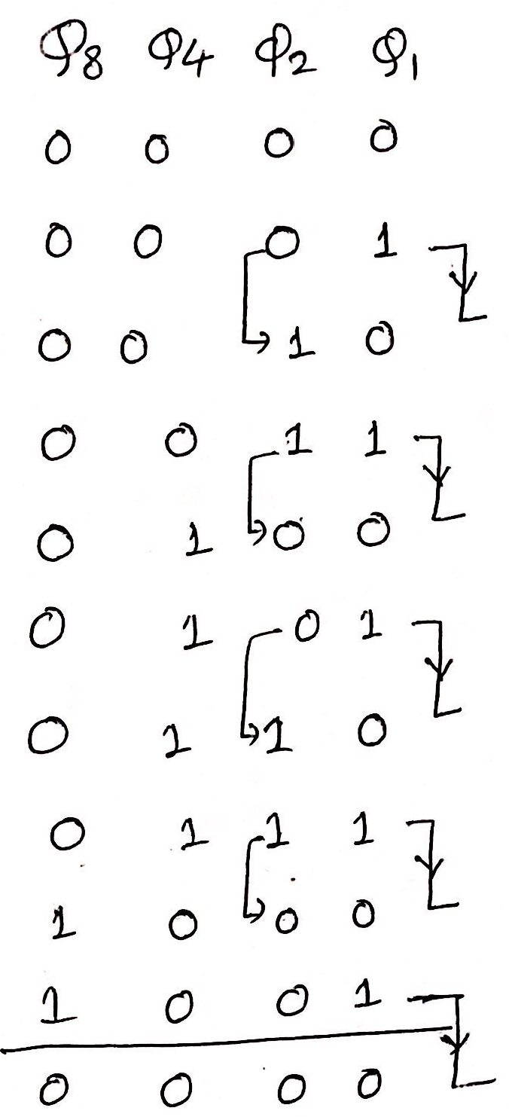
Counting sequence table

Slide 28
Q1 changes state after each clock pulse.
Q2 complements every time Q1 goes from 1 to 0, as long as Q8 = 0.
When Q8 becomes 1, Q2 remains at 0.
Q4 complements every time Q2 goes from 1 to 0.
Q8 remains at 0 as long as Q2 or Q4 is 0. When both Q2 and Q4 become 1, Q8 complements when Q1 goes from 1 to 0.
Q8 is cleared on the next transition of Q1.
The BCD counter of above Fig. is a decade counter, since it counts from 0 to 9. To count in decimal from 0 to 99, we need a two‐decade counter. To count from 0 to 999, we need a three‐decade counter.
A three‐decade counter is shown in the following Fig. The inputs to the second and third decades come from Q8 of the previous decade. When Q8 in one decade goes from 1 to 0, it triggers the count for the next higher order decade while its own decade goes from 9 to 0.

Slide 29
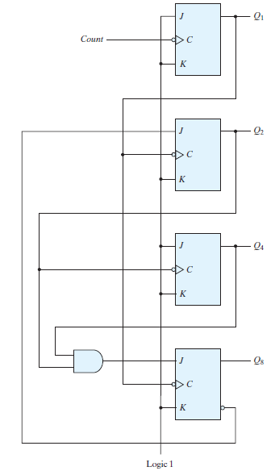
FIGURE: BCD ripple counter

Slide 30
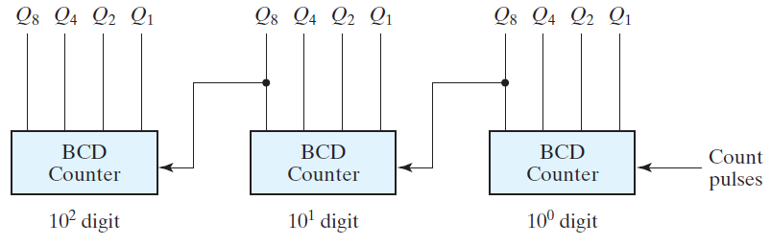
FIGURE: Block diagram of a three‐decade decimal BCD counter.
Design of BCD ripple up counter using asynchronous CLR (active low) input.
What is a divide by n counter?

Slide 31
SYNCHRONOUS COUNTERS
Synchronous counters are different from ripple counters in that clock pulses are applied to the inputs of all flip‐flops.
A common clock triggers all flip‐flops simultaneously, rather than one at a time in succession as in a ripple counter.
Binary Counter:
In a synchronous binary counter, the flip‐flop in the least significant position is complemented with every pulse.
A flip‐flop in any other position is complemented when all the bits in the lower significant positions are equal to 1.
For example, if the present state of a four‐bit counter is A3A2A1A0 = 0011, the next count is 0100.
A0 is always complemented. A1 is complemented because the present state of A0 = 1. A2 is complemented because the present state of A1A0 = 11. However, A3 is not complemented, because the present state of A2A1A0 = 011, which does not give an all‐1’s condition.

Slide 32
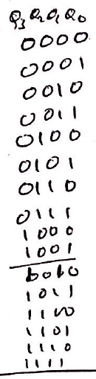

Slide 33
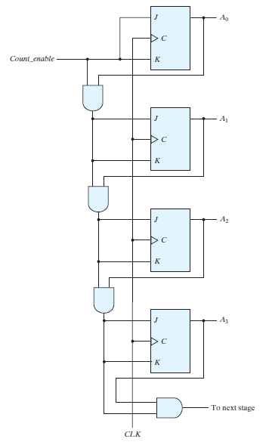
FIGURE: Four‐bit synchronous binary counter

Slide 34
It is possible to design a countdown counter in the usual manner, but the result is predictable by inspection of the downward binary count. (Home work)
The bit in the least significant position is complemented with each pulse. A bit in any other position is complemented if all lower significant bits are equal to 0.
For example, the next state after the present state of 0100 is 0011. The least significant bit is always complemented. The second significant bit is complemented because the first bit is 0. The third significant bit is complemented because the first two bits are equal to 0. But the fourth bit does not change, because not all lower significant bits are equal to 0.
A countdown binary counter can be constructed as shown in the above Fig., except that the inputs to the AND gates must come from the complemented outputs, instead of the normal outputs, of the previous flip‐flops.

Slide 35
Up–Down Binary Counter:
The two operations can be combined in one circuit to form a counter capable of counting either up or down. The circuit of an up–down binary counter using T flip‐flops is shown in Fig. 6.13 (page no. 292) . It has an up control input and a down control input. When the up input is 1, the circuit counts up, since the T inputs receive their signals from the values of the previous normal outputs of the flip‐flops. When the down input is 1 and the up input is 0, the circuit counts down, since the complemented outputs of the previous flip‐flops are applied to the T inputs. When the up and down inputs are both 0, the circuit does not change state and remains in the same count. When the up and down inputs are both 1, the circuit counts up. This set of conditions ensures that only one operation is performed at any given time. Note that the up input has priority over the down input.

Slide 36
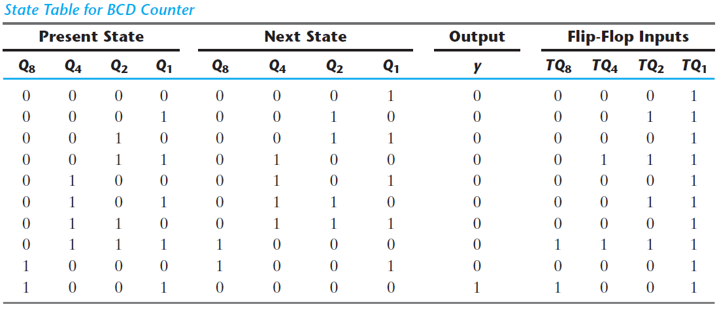
BCD Synchronous Counter:
Design a BCD synchronous counter using positive edge triggered T FF.
Also shown in the table is an output y, which is equal to 1 when the present state is 1001. In this way, y can enable the count of the next‐higher significant decade while the same pulse switches the present decade from 1001 to 0000.

Slide 37
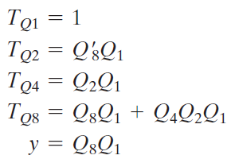
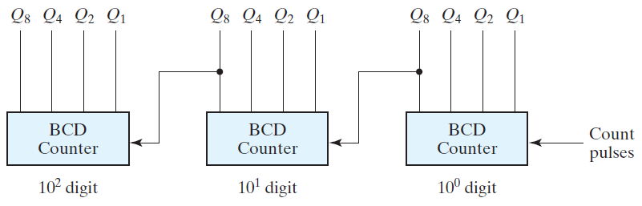
Please write the circuit diagram for above design.
The cascading is done as in Fig. 6.11 , except that output y must be connected to the count input of the next‐higher significant decade.

Slide 38
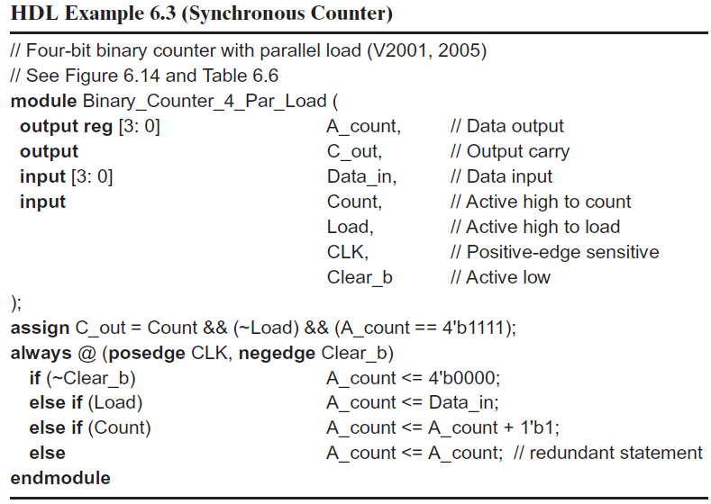

Slide 39
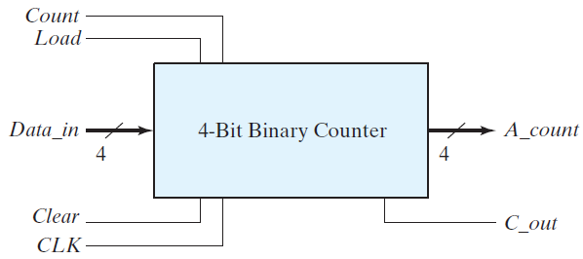
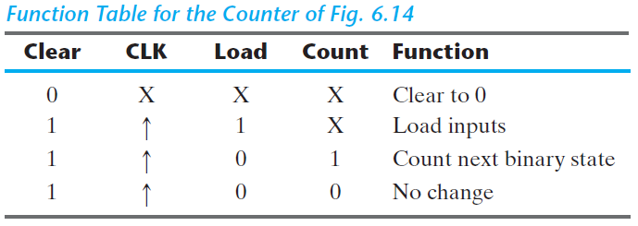

Slide 40
OTHER COUNTERS:
Counters can be designed to generate any desired sequence of states.
A divide‐by‐ N counter (also known as a modulo‐ N counter) is a counter that goes through a repeated sequence of N states.
The sequence may follow the binary count or may be any other arbitrary sequence.
Counters are used to generate timing signals to control the sequence of operations in a digital system.
Counters can also be constructed by means of shift registers (Ring and Johnson counters).

Slide 41
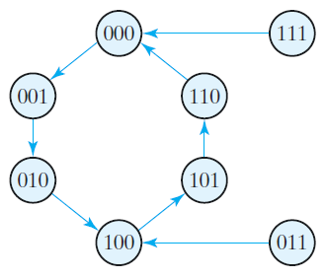
Counter with Unused States
Design a synchronous counter using positive edge triggered JK FFs to generate the following sequence: 0, 1, 2, 4, 5, 6.
Fig: State transition diagram

Slide 42
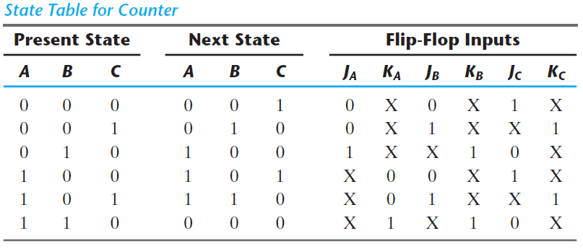
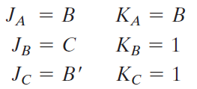

Slide 43
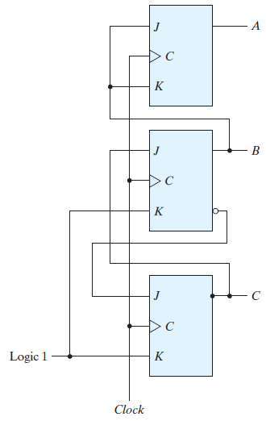
(a) Logic circuit diagram

Slide 44
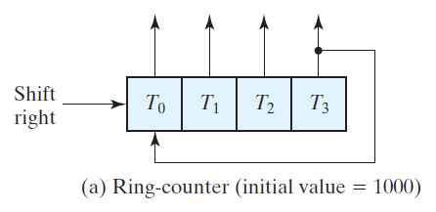
Ring Counter:
A ring counter is a circular shift register with only one flip‐flop being set at any particular time; all others are cleared.
The single bit is shifted from one flip‐flop to the next to produce the sequence of timing signals.
Figure shows a four‐bit shift register connected as a ring counter.
The initial value of the register is 1000 and requires Preset/Clear flip‐flops.

Slide 45
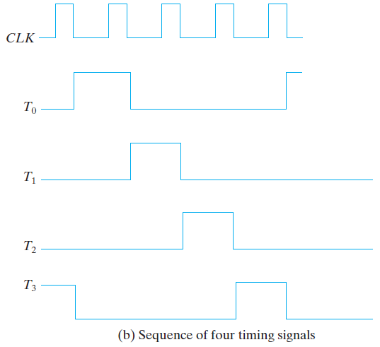
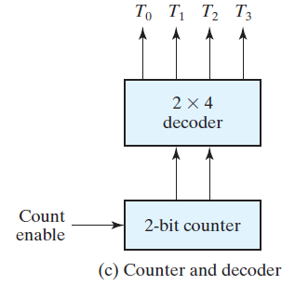

Slide 46
For an alternative design, the timing signals can be generated by a two‐bit counter that goes through four distinct states.
The decoder shown in Fig. (c) decodes the four states of the counter and generates the required sequence of timing signals.
To generate 2^n timing signals, we need either a shift register with 2^n flip‐flops or an n ‐bit binary counter together with an n‐to‐2^n‐line decoder.
Johnson Counter (switch‐tail or twisted ring counter):
A k ‐bit ring counter circulates a single bit among the flip‐flops to provide k distinguishable states.
The number of states can be doubled if the shift register is connected as a switch‐tail ring counter.
A switch‐tail ring counter is a circular shift register with the complemented output of the last flip‐flop connected to the input of the first flip‐flop.

Slide 47
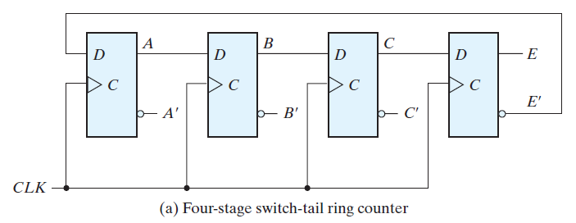
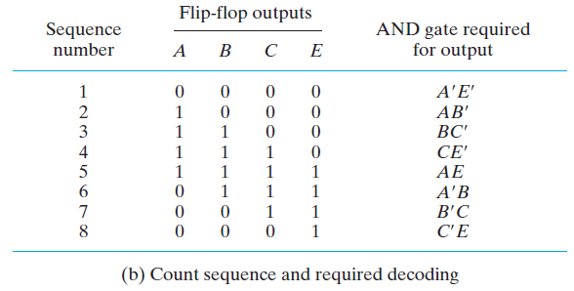
FIGURE: Construction of a Johnson counter

Slide 48
Johnson counters can be constructed for any number of timing sequences.
The number of flip‐flops needed is one‐half the number of timing signals.
The number of decoding gates is equal to the number of timing signals, and only two‐input gates are needed.

Slide 49
